Slide 1
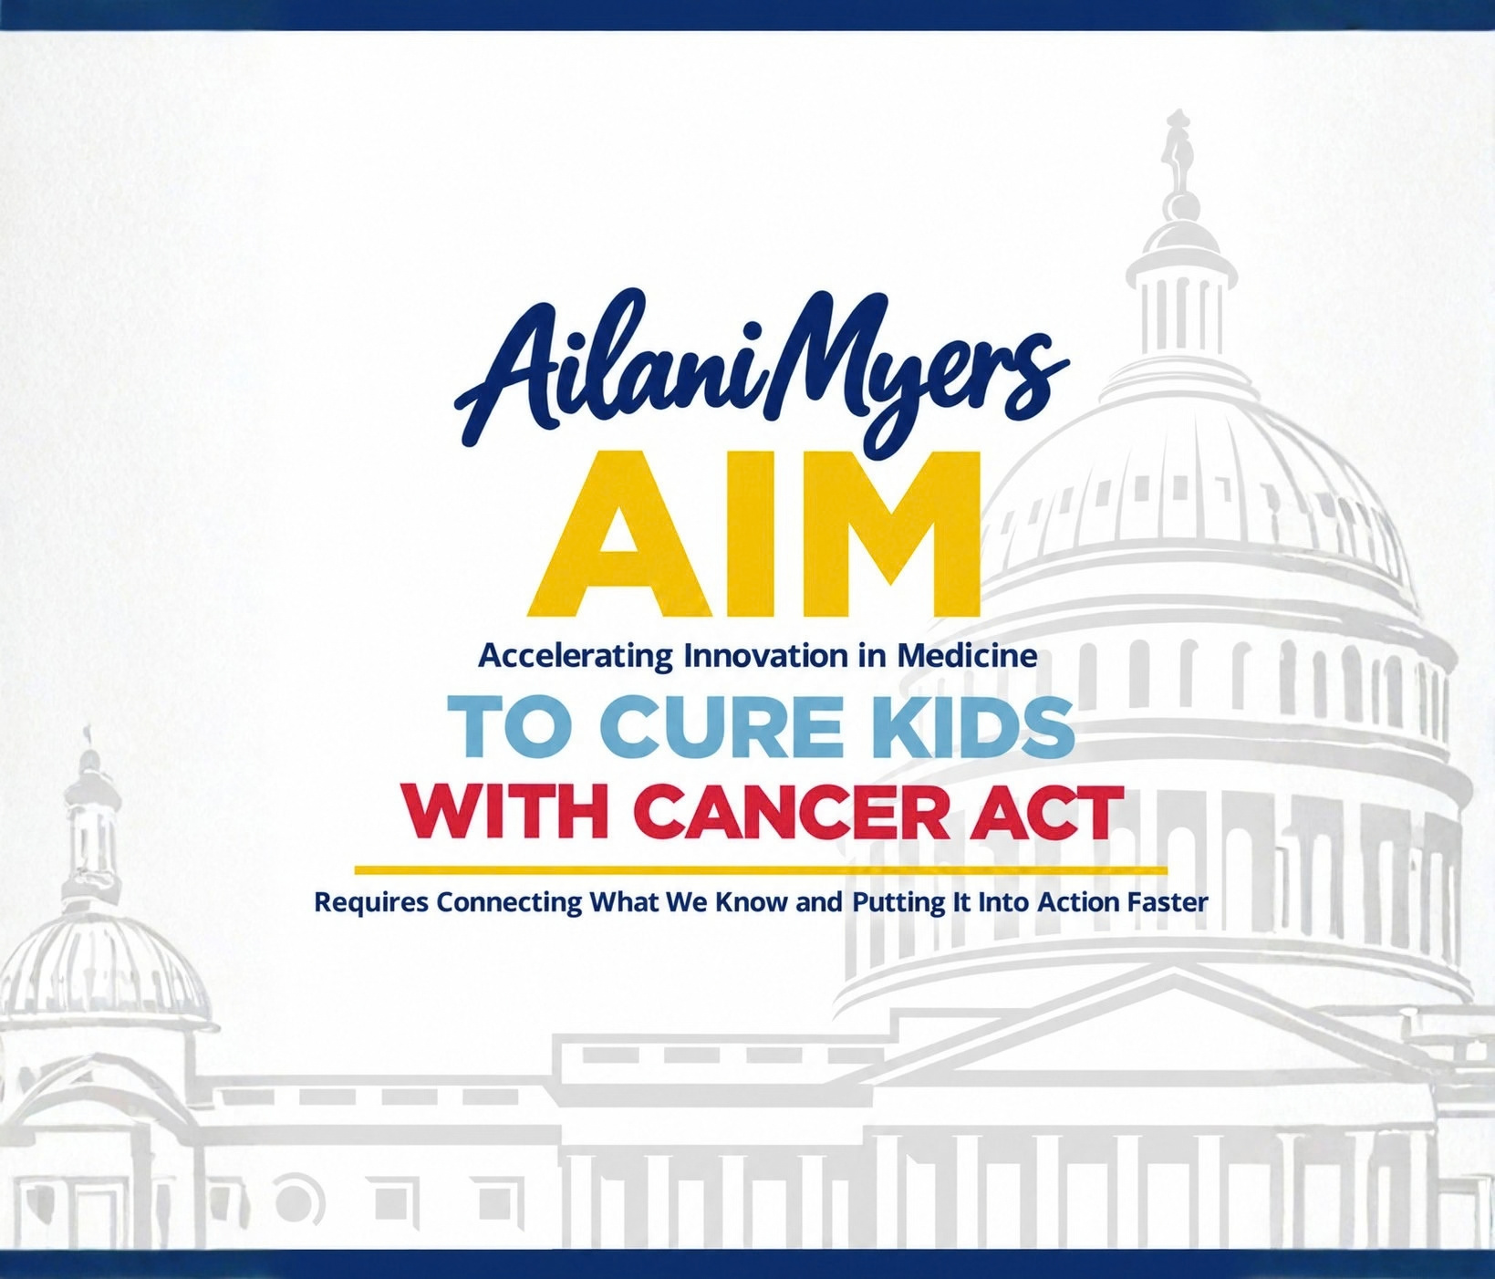

Slide 2
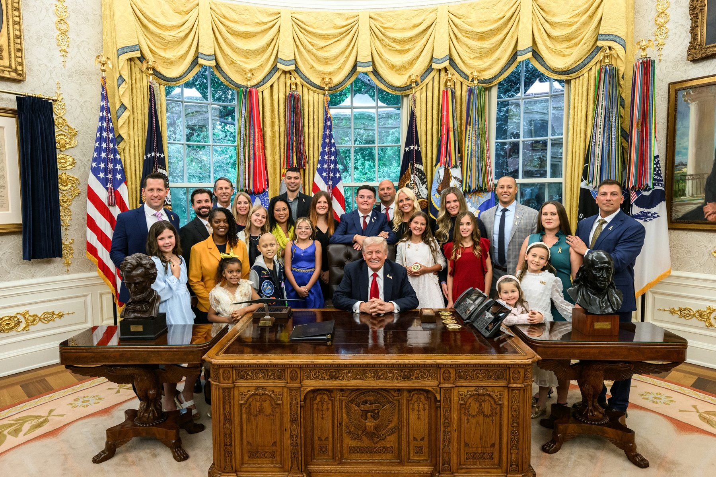

Origin for the Ailani Myers
AIM to Cure Kids With Cancer Act
is Executive Order 14355
E.O. 14355: President Trump issued "Unlocking Cures for Pediatric Cancer with Artificial Intelligence" (Sept. 2025)
Directed: Federal agencies to use AI to speed up diagnostics, research and treatment breakthroughs, building on the data infrastructure of the Childhood Cancer Data Initiative. Prioritizes better clinical trial design, integrated multimodal data, predictive modeling and secure data-sharing standards.
Funding: The administration raised the CCDI budget from
$50 million to $100 million.
r

Slide 3
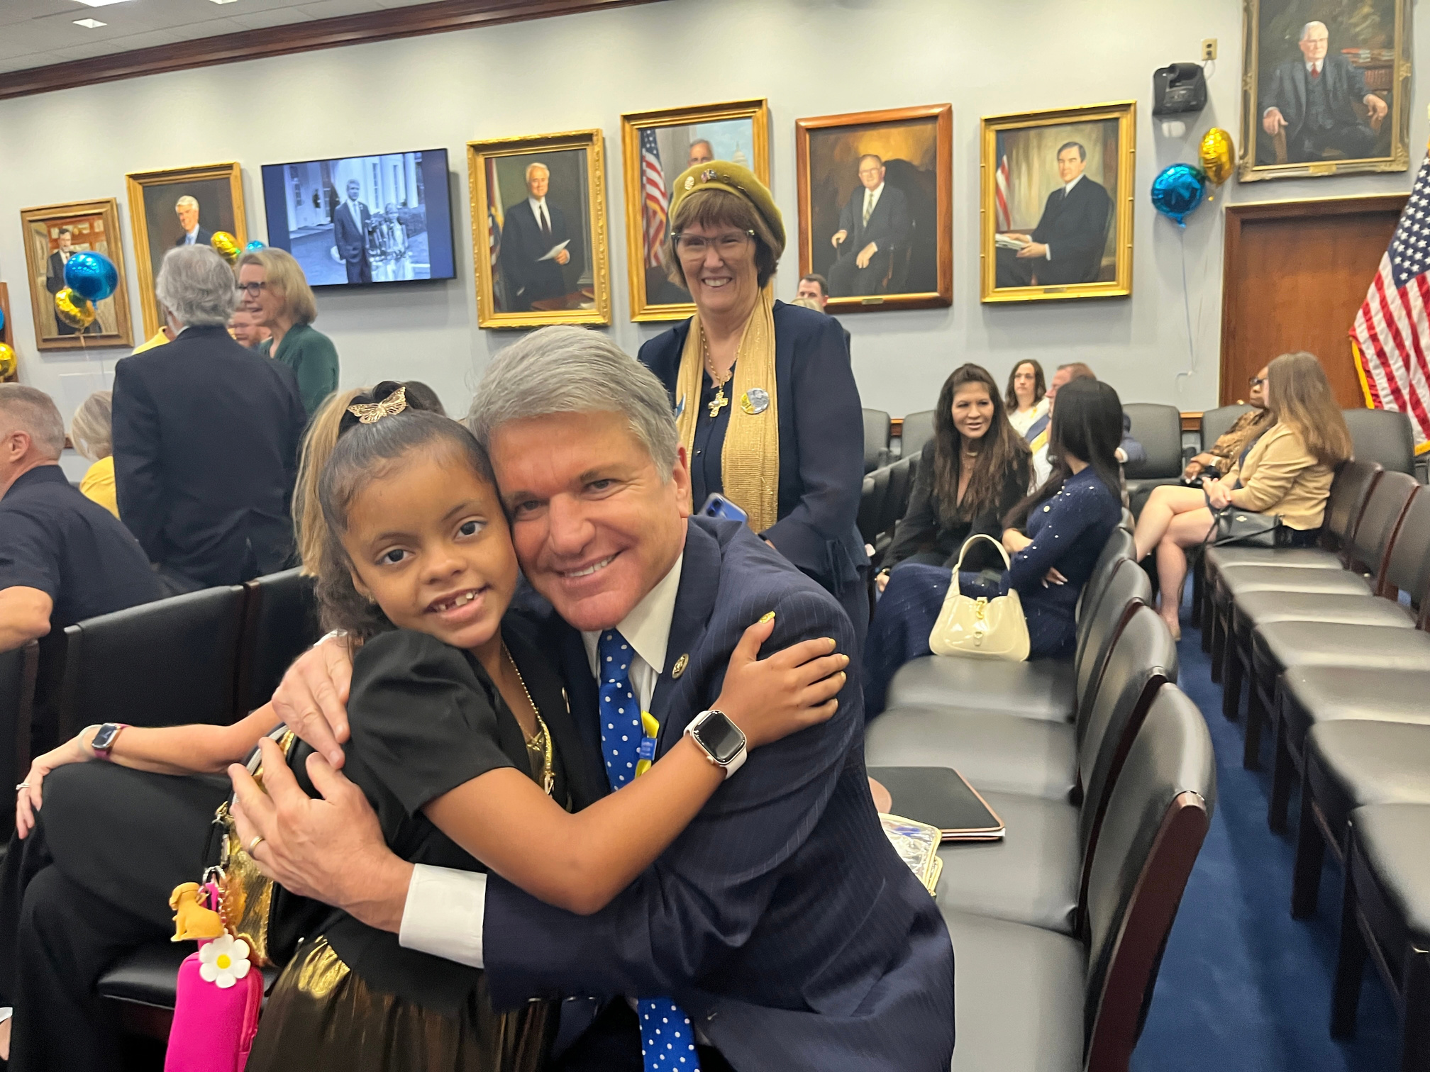
Overview of the
Ailani Myers AIM to
Cure Kids With Cancer Act
The Ailani Myers AIM to Cure Kids With Cancer Act, H.R. 10370,
closely mirrors E.O. 14355, turning it into law.
Requires Connecting What We Know
and Putting It Into Action Faster
Rally Kid Elliot
Bone Cancer
2010-2018
Rally Kid Ailani
Eight-Time Blood Cancer
Fighter and Survivor

Slide 4
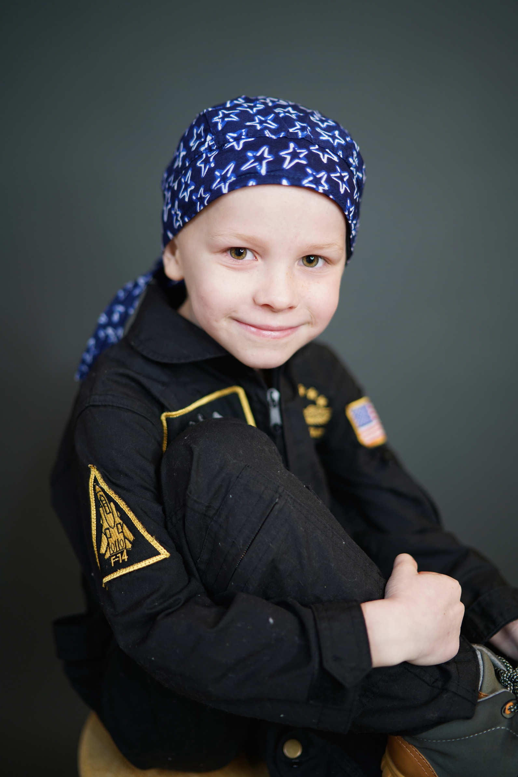
1. Requires Every President to Designate a
Coordinator of AI Innovation
Interagency Coordination and Alignment of Activities for Pediatric Cancer
  HHS Agencies: NIH, FDA, CMS, ARPA-H, and ONC
  Department of Defense Medical Research Program
  Department of Energy, VA, NSF, NIST, and the White House Office of Science and Technology Policy
  External Partners: Patients, Survivors, Families, Caregivers, Researchers and Funders
Giving Childhood Cancer a Permanent Seat at the Table.
Rally Kid Elliot
Bone Cancer
2010-2018

Slide 5

2. Patient Information
All Federal and State Laws Regarding Patient Information will be Followed.
Rally Kid King
Beating Blood Cancer

Slide 6

3. Makes Permanent CCDI
Fact: Currently CCDI is an administrative initiative. It is not an authorized program.
The Ailani Myers AIM Act
Authorizes CCDI Under the NCI Director
Funding: $100 Million Each Year
FY2027–2031
Rally Kid Maybin
Surviving Blood Cancer

Slide 7

CCDI to Collect, Generate, Standardize, Link and Share Data
Required Minimum Data Components Include:
  Molecular Characterization of Tumors
  Functional Precision Medicine
  AI and Non-Invasive Diagnostic Tools
  The CCDI Data Ecosystem
  Rare Pediatric Cancer Data
  The National Childhood Cancer Registry
Requires the Development of Data Standards.
Rally Kid Barrett
Beating Blood Cancer

Slide 8

NCI Director to Harness Innovation
in AI to Accelerate Progress
  Expand AI Data Platforms and Ecosystem Readiness
  Predict Treatment Response, Disease Progression and
Toxicity
  Derive New Theraputic Biomarkers From Molecular and Imaging Data
  Improve Clinical Trials
  Share Methods, Tools, Data Standards and Technical Approaches Across Agencies
Rally Kid Natalee
Beating Solid Tumor Cancer

Slide 9

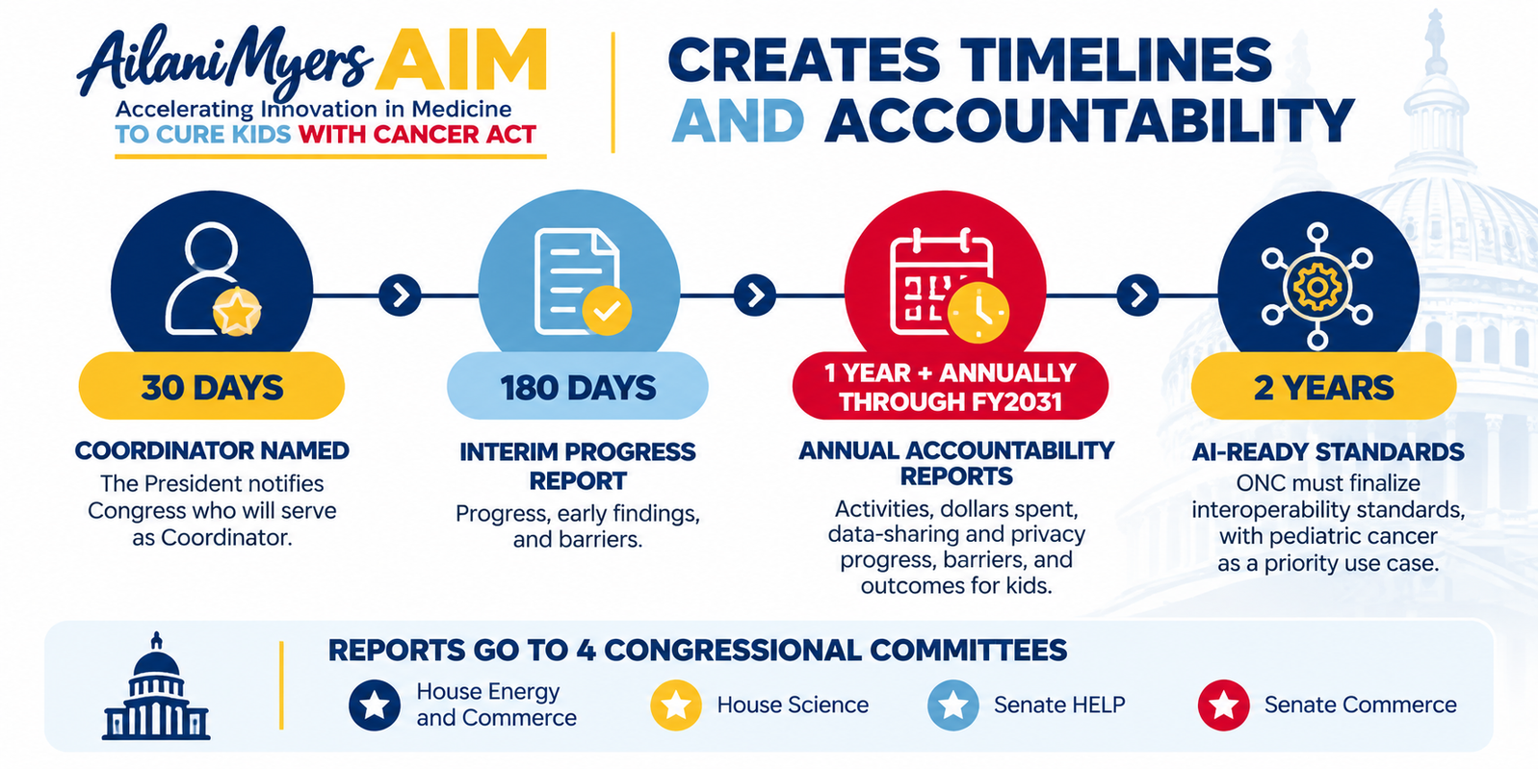
4. Timeline & Accountability
Rally Kid Kobe
Beating Brain Cancer

Slide 10
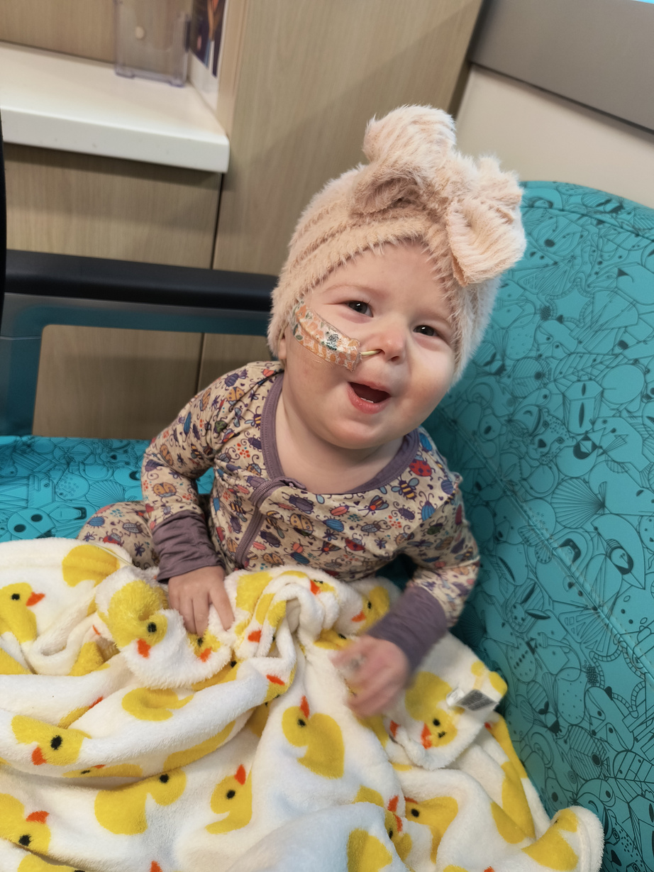
Functional Precision Medicine
What it is: Doctors test drugs directly on a child's living tumor cells to see which treatments actually work.
Why it matters for kids: Many pediatric cancers have few targetable mutations, so testing what works on the actual tumor can open treatment options.
In the bill: Section 201 names "functional precision medicine approaches" as a required part of the CCDI for the first time.
Note: Functional Precision Medicine is one of the top three priorities of the NCI Director.
Rally Kid Ingrid
Fighting Blood Cancer

Slide 11

Senate
There are Ongoing Discussions With the Senate to Introduce the
Ailani Myers AIM to Cure Kids With Cancer Act
Rally Kid Issac
Beating Blood Cancer

Slide 12
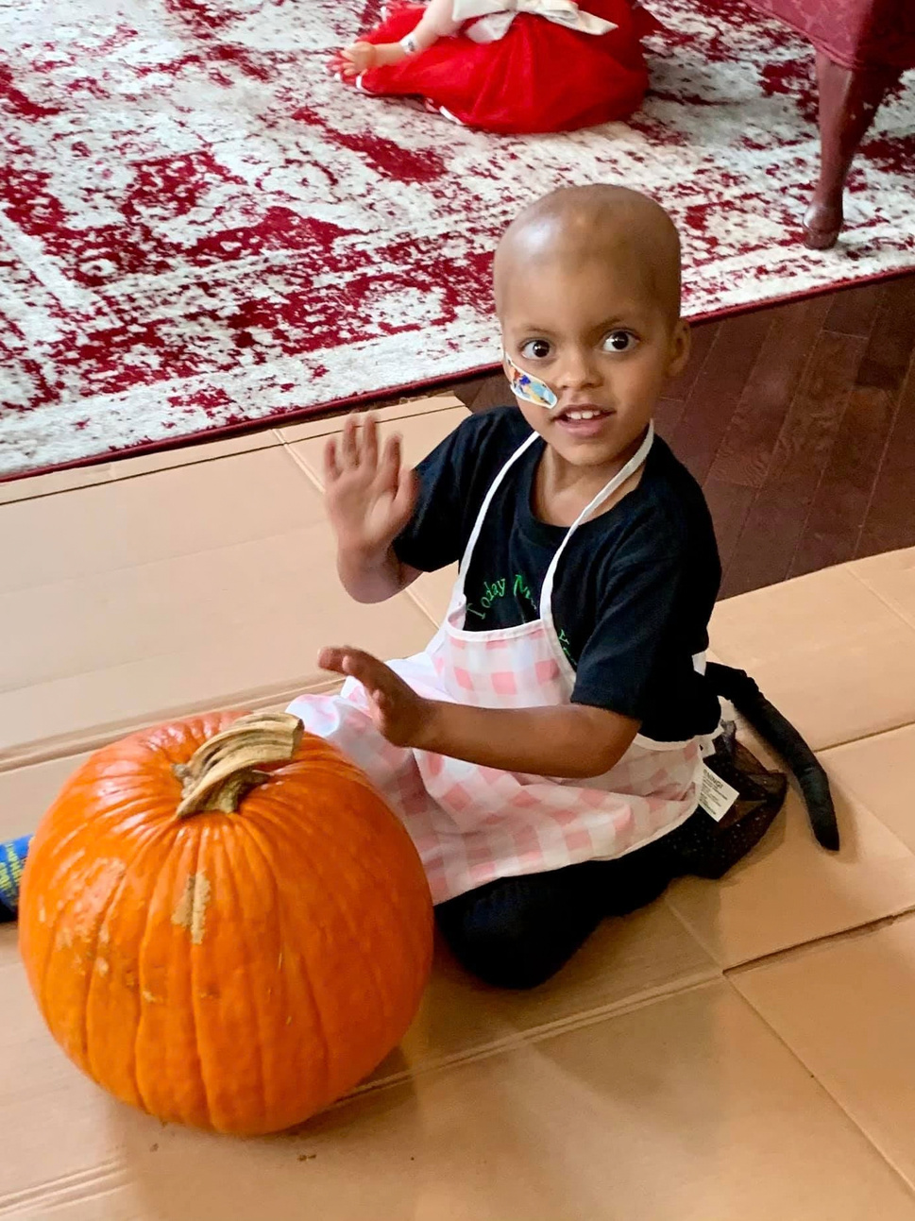
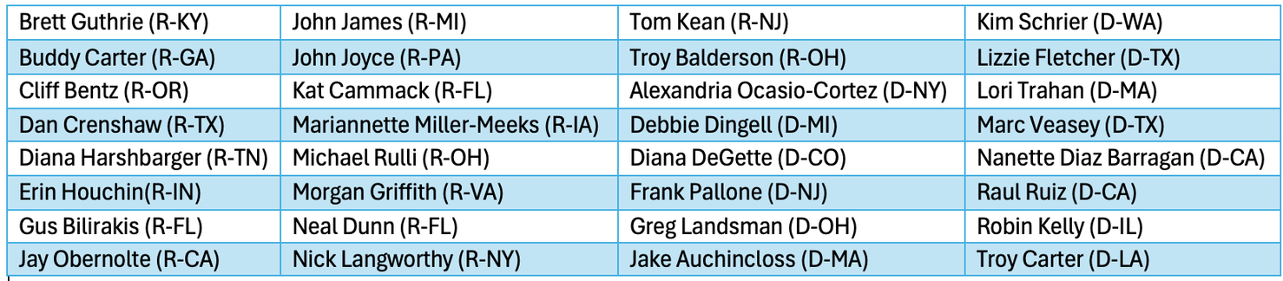
What Can You Do?
Advocacy to the E&C Committee to Pass AIM ACT
Any Connections to
E&C Health Subcommittee Members?
Rally Kid Ailani
Eight-Time Blood Cancer
Fighter and Survivor
r

Slide 13

Congressman McCaul Would Greatly Appreciate the Alliance’s Endorsement

Slide 14


Slide 15
Questions?

